Slide 1
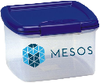
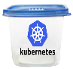
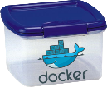
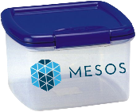


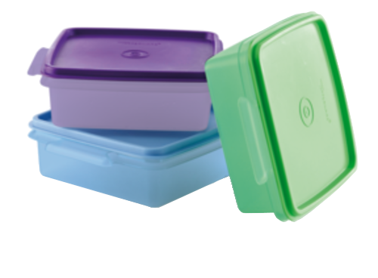


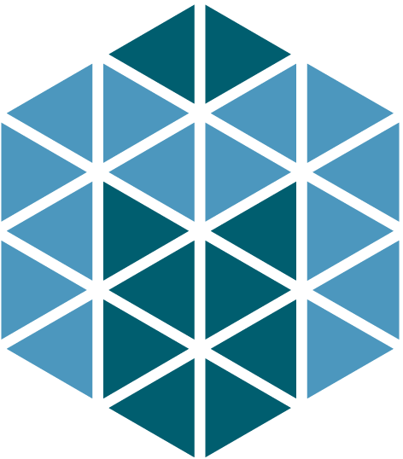



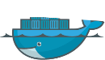

The Messy Middle of Container Platforms

Slide 2
Welcome to TRS!
This is the room you will stay in throughout the remainder of the day (exception for GCN SCs: your hands-on lab will take place in room B308).
Reference your personalized agenda on the back of your badge which lists your mandatory sessions and events, and their locations.
Sponsors with a lime green lanyard not presenting with me are not allowed to stay in the room. (Please exit now.)
Internal Use - Confidential

Slide 3
Intro

Slide 4
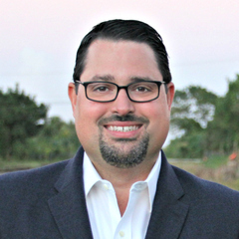



Manny RodP
@mannyrodp‏
Paul Joyce
@storagepedia ‏
Chris McNally
@technologychaos ‏
Kevin Zawodzinski
@kzawo
We are all #PRESALES
Notes:
Intros

Slide 5
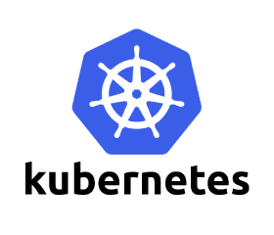
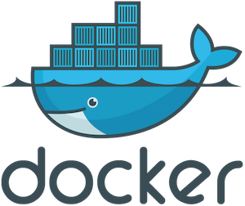

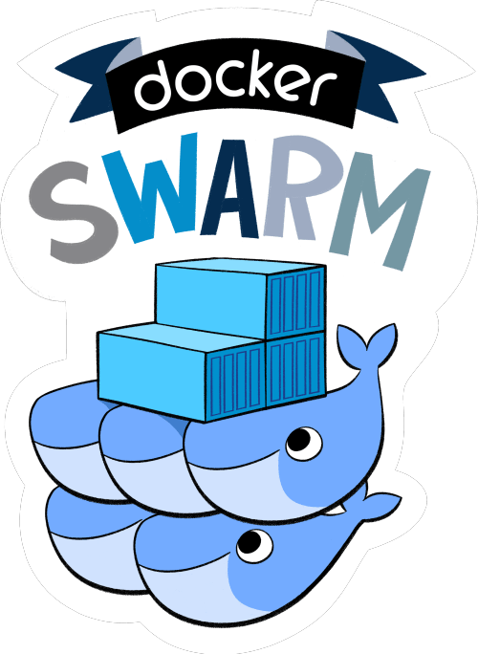
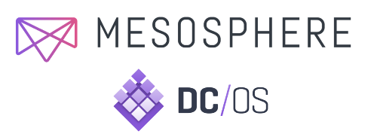
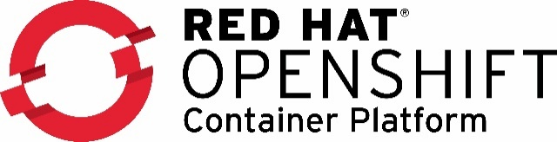
Notes:
Who has heard of Docker?
Who has played with Docker on their laptops?
[click]
What about these other solutions for containers?
Our hope is that you leave here with a good overview
of containers
the platforms companies are using to run containers in production
and become empowered to position Dell Tech solutions for these platforms

Slide 6
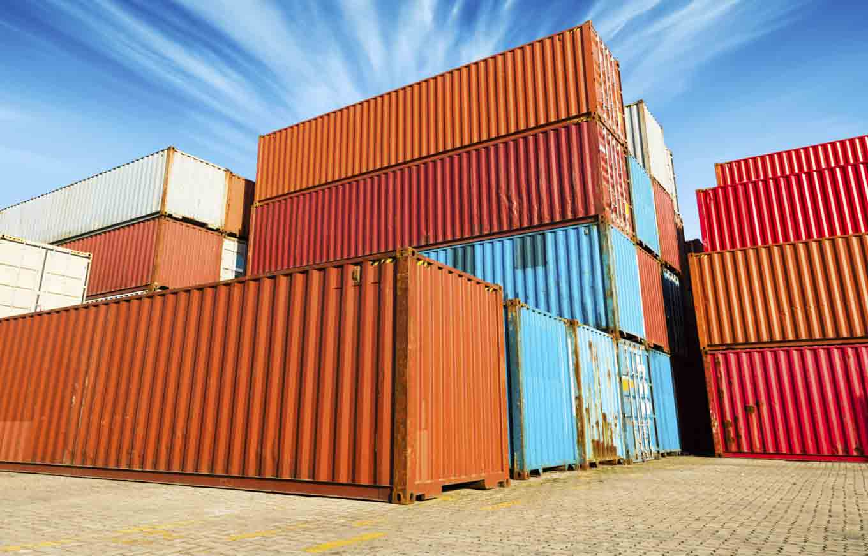
Containers…Yeah!
Notes:
Ok! Who is excited about learning about containers?
Who here wants to know more about how Dell is one of the cool kinds on the block!

Slide 7
Messy Middle

Slide 8
Journey of Instances
Prior to 2000
Physical Servers
2000-2013
Physical Servers
Virtual Machine (VMs)
2013-
Physical Servers
Virtual Machine (VMs)
Containers
What’s Next?
We have more ways of providing infrastructure
Notes:
But first we need to set the stage around containers , our current GTM, and the cloud ecosystem. We do this through a discussion on instantiation , and the instances we provide to app-dev.
Many years ago when we started our journey in distributed IT we delivered physical servers to our customers
[click]
Then a bit before 2000, advancements in processor and memory density started accelerating, and along with Moore's Law, forced the industry to partition servers and drive consolidation ratios through virtualization
[click]
Virtual machines were then added to what types of instances we can deliver.
These instances starting forming a sort of “contract” with applications owners and developers. Its how dev and ops interacts with each other.
In fact how many have we seen a conflict btw devs and ops over vCPU assignments in VMs because VM sizing was one of the key ways dev and ops would communicate
[click]
Fast forward to today and now you not only have physical servers and VMs as instance types
[click]
But you now have containers to support
[click]
and in some cases , like in Pivotal Cloud Foundry or server-less technologies…You have just code artifacts being deployed, and the contract is not a VM or a container
[click]
We live in a time where we have many more ways of providing infra to developers or application owners , and this requires us to think about the different platforms and solutions support these instances.

Slide 9
Deploying VMs
Deploying Containers
Deploying Code
Instantiation
Platforms
Compute/Capacity
Notes:
There is a easy way to look at talk to customers about the ecosystem of instantiation – of deployment of instances – deploying VMs, deploying containers, and deploying code.
Its broken down into three simple layers:
The Instantiation layer - This is where the contract between
The platforms layers – these are the technologies, products and solutions that run and manage the instances
And the Compute/Capacity – These are the on-prem and off-prem technologies and solutions that host the platforms
In some cases these layers over lap , however this will be an easy way to talk about customer the ever-changing ecosystem around these instances

Slide 10
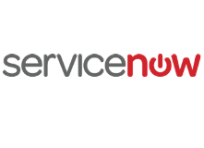
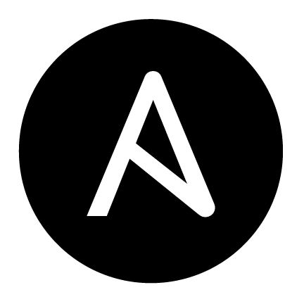
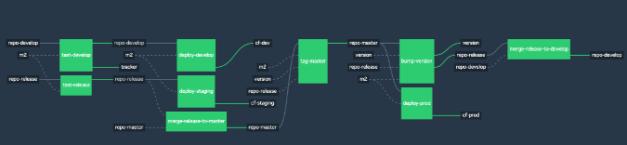
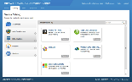
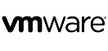


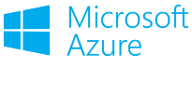

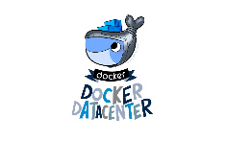
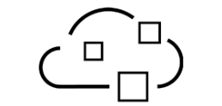
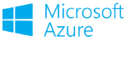
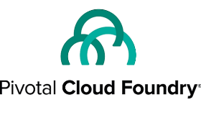
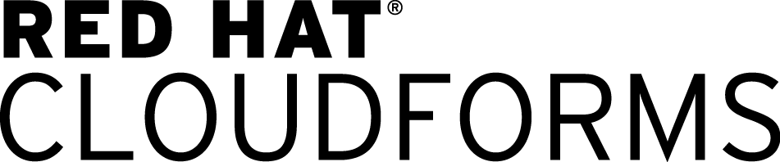

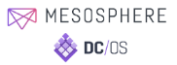
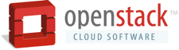
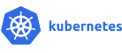

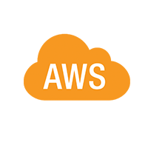
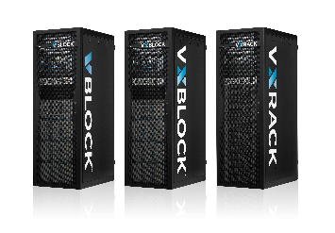
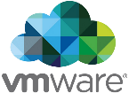

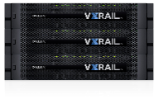
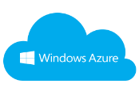

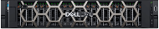
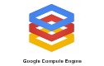
Deploying VMs
Deploying Containers
Deploying Code
2
1
3
Portals
Scripting
CI/CD Pipeline
Instantiation
vRealize Suite
In general we see three ways instances are being instantiated:
Use custom scripting tools to develop your instantiation process
Deploy a service catalog portal with predefined set of services
Deploy a CI/CD tool chain that integrates code deployment and testing and give developers control
VM CMPs
DIY Container
M&O
Commercial
PaaS and CaaS Suites
Platforms
Platforms
vRealize Suite
On-premises
Off-Premises
Compute/Capacity
Servers
HCI
Ready Systems
Standardized
Specialized
Notes:
The first layer is the instantiation layer – this is where infrastructure interacts with the applications and developers to deplo instances – deploying VMs, deploying containers, or deploying code artifacts. There are 3 major approaches we see at customers:|
The first approach we see, in the middle top, is the classic service request plus scripting approach - A customer opens a ticket and some process is initiated to deploy something, mostly through a chain of sysadmin activities on workstations/laptops or from a centralized server. The best shops in this mode have moved on to using auto configuration tools like Puppet to create consistency. But we have also seen very manual processes too, including spreadsheets and the like.
On the left side you have the structured portal. This is where we create a catalog of services , mostly around deploying VMs , and provide access to app/dev stakeholders to create their own instances. This has become a key component in cloud strategies for customers and is core to our EHC cloud solution. This approach is a highly governed model and puts some guardrails on what can be instantiated. App/dev can only deploy the instances and workflows that are provided to them and in most cases changing workflows can involve many stakeholders and interdependencies.
On the far right side is the 3rd major approach – where Continuous integration , continuous delivery tools are chained together to form a pipeline . In this approach the control is given to app/dev to instantiate what they need. All we give to app/dev is a pool of capacity and some APIs. There is still some governance required , especially around security , however it is much more flexible.
In some cases these can be combined , especially 1 & 2 , in a phased approach to getting to a full self-service catalog.
Note that you can use any of these instantiation method with any instances - ie CI/CD pipeline with VMs , in fact that’s where CI/CD pipeline started.

Slide 11
Deploying VMs
Deploying Containers
Deploying Code
Portals
Scripting
CI/CD Pipeline
Instantiation
vRealize Suite
VM CMPs
DIY Container
M&O
Commercial
PaaS and CaaS Suites
Platforms
Platforms
vRealize Suite
This is the continuum of cloud platforms customers would consider to support the management and orchestration of instances.
On-premises
Off-Premises
Compute/Capacity
Servers
HCI
Ready Systems
Standardized
Specialized
Notes:
The next layer is the platform layer – or the continuum of cloud platforms that customers would consider to support the management and orchestration of instances. We organize this layer into 3 major buckets.
On the left side you have your virtual machine cloud management platforms like VMware’s vRealize or our turnkey vRA solution Enterprise Hybrid Cloud (EHC). Note there is also Azure / Azure Pack, RedHat CloudForms, and Cisco UCS Director being used by our customers to deploy VMs.
In the middle you have the Do-it-yourself (DIY) container Management and Orchestration (M&O) solutions -
On the right side are the cross-cloud PaaS Suites that are mostly container based but can be VM based.
Hyper-V, KVM and VMware ESXi/vSphere were excluded as they are infrastructure cluster managers and hypervisors – not to minimize their importance – but to stress that the focus on platform orchestration.
One word of caution, This is not meant to be a decoder ring , read strictly from top to bottom. We all know that customers environments are all slightly different. This is meant as simple way to describe what I happening in the cloud solutions ecosystem and drive a discovery discussion with customers.

Slide 12
Deploying VMs
Deploying Containers
Deploying Code
Portals
Scripting
CI/CD Pipeline
Instantiation
vRealize Suite
VM CMPs
DIY Container
M&O
Commercial
PaaS and CaaS Suites
Buy an XaaS Engineered Solution for Traditional Apps
Buy an Cloud Agnostic PaaS
for Cloud Native and Java Apps
Platforms
Platforms
vRealize Suite
Dell EMC has most uses cases covered with bookend turnkey solutions – vRA/EHC for XaaS and PCF/NHC Cloud Native
On-premises
Off-Premises
Compute/Capacity
Servers
HCI
Ready Systems
Standardized
Specialized
Notes:
We have done a great job of positioning solution on both bookends of this continuum
On the left side delivering Vmware vRealize Suite for VM based portals , and delivering to customers a turnkey solution in XaaS with EHC

Slide 13
Deploying VMs
Deploying Containers
Deploying Code
Portals
Scripting
CI/CD Pipeline
Instantiation
vRealize Suite
VM CMPs
DIY Container
M&O
Commercial
PaaS and CaaS Suites
Platforms
Platforms
vRealize Suite
However your customers may be deploying in the “Messy Middle”
A place of continuous change, new products and solutions, and most of all OPPORTUNITY
On-premises
Off-Premises
Compute/Capacity
Servers
HCI
Ready Systems
Standardized
Specialized
Notes:
However vRealize and EHC or Pivotal Cloud Foundry (PCF) and Native Hybrid Cloud (NHC) may not resonate with you customers. Or maybe your customer has a partnership with a HP or IBM. Maybe they already have some technical debt in one of these platforms. Your customers may be deploying in what we call the “Messy Middle” - A place of continuous change, new products and solutions, and most of all OPPORTUNITY….. Why opportunity?

Slide 14
Deploying VMs
Deploying Containers
Deploying Code
Portals
Scripting
CI/CD Pipeline
Instantiation
It all needs infrastructure!
vRealize Suite
VM CMPs
DIY Container
M&O
Commercial
PaaS and CaaS Suites
Platforms
Platforms
vRealize Suite
On-premises
Off-Premises
Compute/Capacity
Servers
HCI
Ready Solutions
Standardized
Specialized
Notes:
Why bc it all needs Infrastructure, off=premises and on-premises
and while a few customers are looking off-premise for these instances a large majority will need on-prem infra
[click]

Slide 15
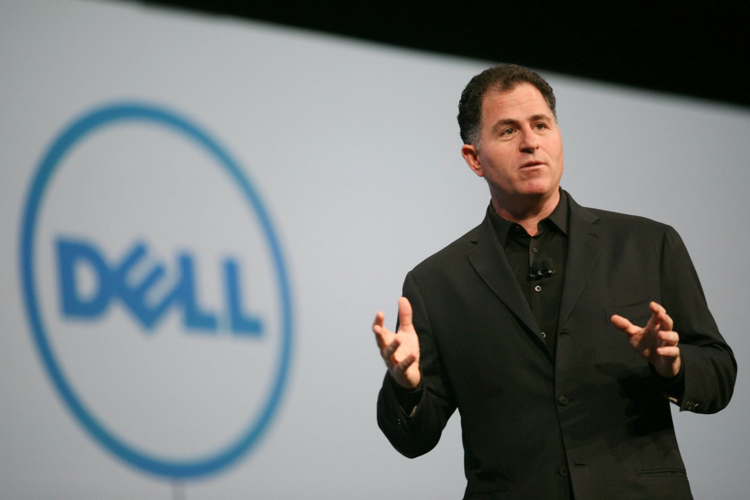
Choice & Flexibility
We’re maintaining and investing in strong independent ecosystems and open architectures so customers have choice and flexibility
- Michael Dell , DEW 2016 Keynote
Notes:
In fact at the core of our strategy is to provide customers choice and flexibility
And one way we are delivering choice and flexibility to customers is through investing in independent ecosystems and open architectures
This could be through our strategically aligned businesses or through open source and foundations, or even through evangelism and IT advocacy
[click]

Slide 16
Deploying VMs
Deploying Containers
Deploying Code
Portals
Scripting
CI/CD Pipeline
Instantiation
vRealize Suite
VM CMPs
DIY Container
M&O
Commercial
PaaS and CaaS Suites
Platforms
Platforms
vRealize Suite
On-premises
Off-Premises
Compute/Capacity
Servers
HCI
Ready Systems
Standardized
Specialized
Notes:
So back to the messy middle – where there is industry trends and activities that impact us
Note that there are several technologies and platforms listed here , and there are many more that are worth going over
Our wish is that this becomes a regular series of learning where we can cover
New VM orchestration technologies and platforms
Autoconfig tools like Chef, Puppet and Ansible
Pubic cloud offerings and tools
As well as emerging practices, such as DevOps and Infra as Code
[click]

Slide 17
Deploying Containers
DIY Container
M&O
Commercial
PaaS and CaaS Suites
On-premises
Servers
HCI
Ready Solutions
Notes:
Today we are going to focus on two areas of opportunity :
The container platforms
And on-premises solutions for these platforms
There is a lot of hype about containers , however to a lot of us it feel like we are at the beginning of a fundamental shift in how infra gets delivered and the interaction btw Ops/Infra and app-dev
To me it feels like I am back in 2004-2007 (mid 2000s) , when VMs were taking off , and you have this great dialog in the industry around what can get virtualized and how to manage VMs at scale, and all these new tools were being developed , new companies were popping up
When I I think about containers it takes me back to VMWorld 2006 in or VMWorld 2007 in , those were amazing times when everything seemed so awesome so new and fresh
Lets see what containers are all about….

Slide 18
Containers 101

Slide 19
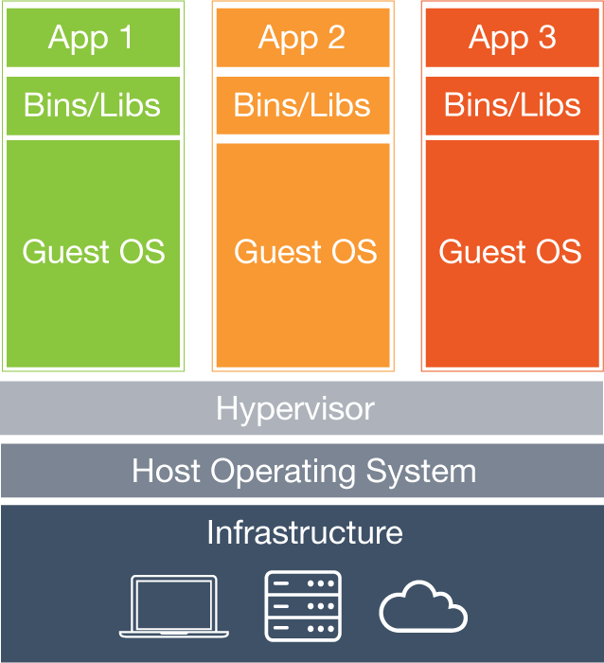
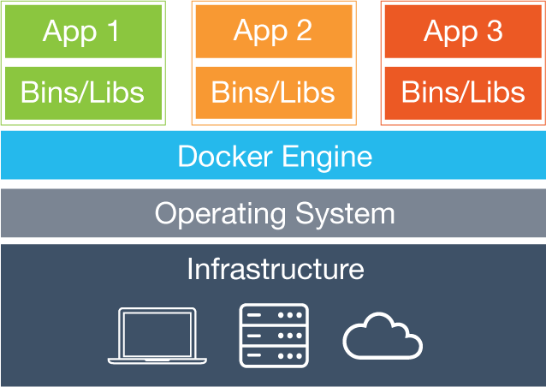
Containers vs VMs
Deploying VMs
Deploying Containers
Traditional cloud instance with broadest adoption and platforms
Requires full OS
Next gen cloud instance
Shared Kernel
Super fast instantiation
Very portable
VM
container
Hypervisor
Container Engine
Notes:
Best way to explain containers is to compare to something we know and hold dear – Virtual machines
VMs are just a mirror image of a server – virtualization creates a mirror image of a server
That means you have a full OS
Think about what that OS does – translate HW to an App and APP to HW
And with utilization rates for VMs averaging 20-50% in most companies
Now think about all the VMs running in a typical enterprise -100’s maybe 1000’s of VMs – all with there own OS
VMs are not going away – they still needed for a lot of reasons
Some apps wont be put into containers
Some apps only run on VMs , ISVs
Like the other critical heritage environments – Mainframes for instances – VMs will still be needed
Right now the industry is heavy into the debate on whether things like Oracle DBs should be put into containers – sound familiar?

Slide 20
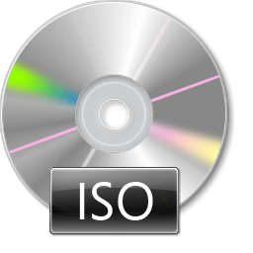
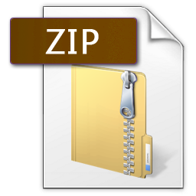
Another way to think about it…
Deploying VMs
Deploying Containers
100’s MBs – X GBs
MBs – 100s MBs
Notes:
Here is another way to look at the differences – ISO image vs ZIP file
VMs are like ISO images – they have everything they need to boot a server image and run an OS and applications, you can apply an ISO to a bare metal server to build a full server
Containers are like zip images , zips are just a package of files and maybe applications, you cant install a ZIP file on a bare meatl server – you need an OS plus some other things.

Slide 21
Linux containers are built on…
Linux Containers
namespaces
cgroups
SELinux / AppArmor
Purpose | Isolates and virtualizes processes | Limits and accounts for resources | access control security policies and profiles
Initial Release | 2002 (15 yrs ago) | 2007 (10 yrs ago) | 1998 (19 yrs ago)
… and have been around for over 10 years.
Notes:
Containers originated form the UNIX/Linux world
Containers in Linux are made possible by a few key features built into the Lunix kernel that isolate processes and limit resources.
The actual purpose of each component is not that important
What is important is how long these components have been around , one almost 20yrs !!!
So the questions one would ask is , Why are we taking about containers now?
So in the last few years , people have tried to leverage Linux containers and develop different approaches to tools
[click]

Slide 22
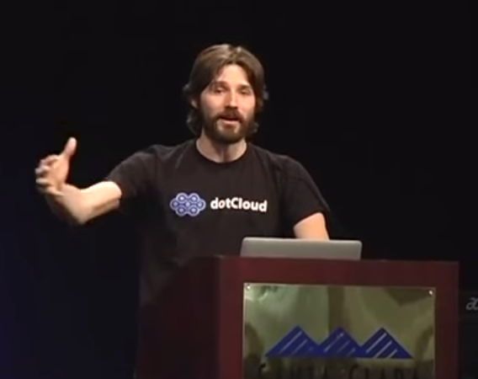
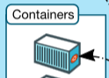


Docker – Why all the Hype?
Solomon Hykes shows Docker to the public for the first time at PyCon 2013
5 min lighting talk - https://www.youtube.com/watch?v=wW9CAH9nSLs
Developer friendly wrapper and API around Linux containers
Makes packaging and distributing software along with its dependencies very very easy
Almost all platforms and clouds now support AND promote Docker as their container image and/or engine standard
is to
what
is to
Notes:
This is where a guy named Solomon Hykes comes in….
In 2013 (just 4 years ago) Solomon gives a a lightening talk at the annual Python conference – Pycon
If anyone’s has done a lightening talk , you know how hard it it – its 5 min , slides are suppose to advance every 20 secs automatically
So Solomon gets up and says something like – “hello everyone I work at dotCloud and we developed a cool tool to deploy customers apps called Docker, let me show you…”
He got a standing ovation…and Docker was born
4 years later and Docker is the fastest growing technology of all time
With over 14B+ downloads in July 2014
And what Docker does is make containers easy to create , deploy, and managed by putting developer friendly wrapper around them
The key word here is “Developer” , and when taken on context of our new software and developer focused world – makes sense why Docker came at the right time
When I talk to Developers they describe Docker as extremely easy and empowering
This is why Docker has become the defacto standard for defining container image on all pat forms and clouds

Slide 23
Docker Files
Docker file is a text file that defines the container image and application dependencies
Container images can be layered in a file
Container
FROM ubuntu:latest
Set entry point
RUN apt-get install –y redis
Expose port
EXPOSE 6379
ENTRYPOINT [“/usr/bin/redis”]
Add application
Want to deeper knowledge on Docker and containers? Contact the Dell EMC dotnext team @ dotnext@dell.com
Start with base image
Notes:
So this will be one of the most technical topics we will discuss today, the Docker File Stadard
This will help you understand what these things look like
The beauty of Docker is that a container can be defined trough a simple commands and file
Also Docker containers can be layered on op of each other as to create a hiercahy
Lets go through a simple example Docker file
The first line defines the base container image , and in this case it is getting the latest Ubuntu image from the public Docker repository
Then we define the application
Then maybe open a port
And lastly in this example , set an entry point for the app and SSH
As you can see its very simple to specify an entire app environment with dependencies
And this stays consistent no matter where deployed
The purpose of today is to expose you to the world of containers , we wont go any deeper than this . if you want to go deeper contact the dotnext team . They have a lot of great content available including hand-on workshops.

Slide 24


Consistency and Decoupling Throughout the Process
Define the App Environment
Developers
Container maintains consistent environment for application/code throughout the development and deployment process,
Apple OSX
Ubuntu
CentOS
Kubernetes
CoreOS
Container can be deployed and run virtually anywhere
MAC Laptop
AWS EC2
Cloud X
Hyper Converged
Development
Unit Test
Integration
Prod
Operations
Notes:
We mentioned that one of the main benefits of container is consistency
a developer specifies an environment through a file , which we saw was pretty easy
And then that environment , aka the container, stays consistent throughout a deployment or location
[click]
For instance , lets say a developer creates a container and adds his code on his.her laptop , which happens to be a Macbook running OSX
Once they are confident that they can move to the next steps , say some form of Unit testing, the container can be moved to a toyally differnet environment, say Ubuntu linux running on AWS, and the container

Slide 25
Why the LOVE for Containers?
Developers love containers …
Control
Consistency
Portability
Operations [should] love containers ...
Modernize Applications & Operations
Prevent Configuration Drift
Are Cloud/Infra Agnostic
… and the business will love the SPEED
Notes:
- Appeal to Ses to become tip of spear - embrace

Slide 26


Laptop Nirvana
Laptop
Container Standard
Love them Docker containers!
C
C
C
C
C
C
C
C
C
C
Its only your laptop, dude!
C
C
C
C
Container Engine

Slide 27

… Production Reality … Need a PLATFORM
Orchestration
Clustering
Fault tolerance
Scalability
Networking
Service Discovery
Container Image Mgmt
Security
Logging & Monitoring
App Perf Mgmt
etc…
Container Standard
Logging, Monitoring, & APM
Security Mgt
Secrets, Certs, RBAC
Image Mgt
Registries, Hubs
Adv Service Discovery
Networking Overlay
Container Engine
Orchestration and Clustering

Slide 28
Container Platforms Deconstructed

Slide 29
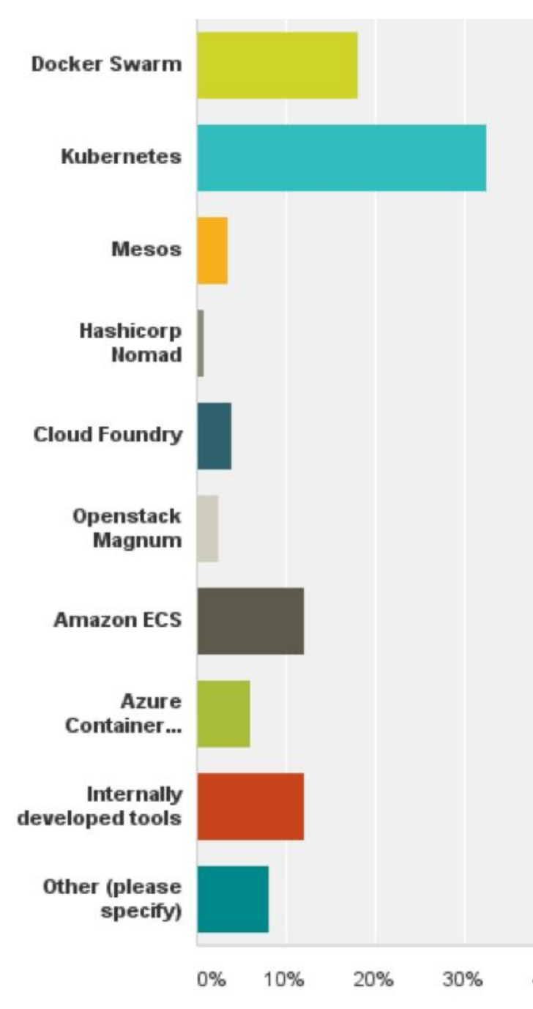
Container Platform Adoption
We typically see 3 open source based container platforms on-premises
Src: Portworx Annual Container Adoption Survey 2017 , n=491 IT pros
https://portworx.com/wp-content/uploads/2017/04/Portworx_Annual_Container_Adoption_Survey_2017_Report.pdf
Notes:
Measuring container platform adoption is difficult – one place to look is surveys and reports , however I find them biased
Not a lot of good survey’s due to Bias or questions being too broad , for instance “which DevOps tool do you use”
Out of all I have seen - I like this survey from PortWorx , which was taken at the annual Docker conference , DockerCon this year
It has a bias of course bc it was done at a container conference
Also disclaimer Portworx is a competitor, they have a software defined storage solution like ScaleIO plus container platform integration
However I like it bc it asked two questions:
One it asked what platform was being used – select all that apply
And more importantly it asked – what platform was used more – which no other survey considered.

Slide 30
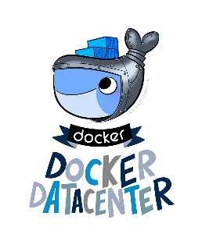



Container Platform Adoption
We also see the commercial platforms based on OSS platforms
Commercial Platform
OSS Platform
Notes:
You may also hear or see some commercial distributions of these platforms
The most popular K8s distros in the IT shop we cover it seems to be RedHat OpenShift
Docker packages up some tools and Guis around Docker Swarm to create Docker Datacenter which is Licensed under Docker Enterprise
Mesos is the foundation of Mesosphere DC/OS
And of course as a comparison - Pivotal Cloud Foundry , based on Cloud Foundry
There are some others that we didn’t mention here , like CoreOS Tetonic , which is based on K8s, these seem to be the ones we encounter the most.
Going forward we would like to know what you are seeing out there , so we will figure out a way of getting this info to/from the collective SE community

Slide 31
… Platforms vs Orchestrators
Industry generally refers to the OSS as CONTAINER ORCHESTRATORS or COs
However ….they are becoming more platform-like with advanced features beyond orchestration
… we will refer to these as PLATFORMS and differentiate btw commercial and OSS
Commercial Platform
OSS Platform
Disclaimer: Pivotal does not see these as platforms.
Notes:
We have been using the term “container platform” , however I want everyone to know that the industry refers to the OSS solutions as “container orchestrators” or “COs”
If you listen to for instance the container gurus talking lets say on a podcast like the Google Compute Cloud podcast, you will hear them refer to these as Cos
However we believe that these solutions are going beyond orchestration and becoming more platform-like as they incorporate more network, security and management functionality
So for simplicity sakes we will continue to refer to these as container platforms for this preso
Note that Pivotal do not consider these as platforms and may be offended if you do, so be mindful.
Okay so lets jump into these a bit and learn a bit more about them so you can be dangerous
[click]

Slide 32
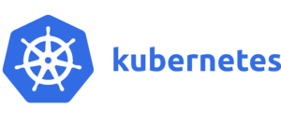
Top 5 Things to Know
Referred to as “K8S” (8 letters btw K & s)
Developed by Google’s engineers based on theirs own platforms Borg & Omega
Cloud Native Compute Foundation
Best momentum and largest community
Most modular and also most complex to learn
Notable Users | Birth Days
Ancestry.com Pokemon GO Concur | Alpha – 2014 1.0 - 2015

Slide 33

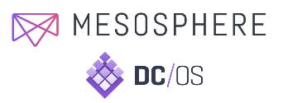
Top 5 Things to Know
Commercial support by Mesosphere (DC/OS) based
Started as a UC Berkeley research project
The Apache Foundation
Two-level scheduler allows for containers and and data frameworks i.e. (Spark, Cassandra, Kafka)
Oldest and most proven at scale (Twitter, Uber, Apple, NetFlix)
Notable Users | Birth Days
Twitter AirBnB Autodesk | Alpha – 2010 1.0 – 2016

Slide 34
Top 5 Things to Know
Docker Datacenter adds management tools to Swarm
Swarm added to Docker as a core component
Focuses on ease of use & easy setup
Less mature than Mesos or Kubernetes
Primarily developed by Docker, Inc., smallest community
Notable Users | Birth Days
ICANN (aka Internet DNS) | Alpha – 2014 1.0 - 2015

Slide 35

Top 5 Things to Know
RedHat’s commercial platform based on K8S
Adds developer and management tools
Most heard about commercial platform for on-premises
RedHat provides a dedicated hosted model too
RedHat will position their scalable NAS solution Gluster, work with them on ScaleIO
Notable Users | Birth Days (for OpenShift Orgins)
FICO BMW Group FL Blue Cross and Blue Shield | Alpha – 2012 (first versions were not based on K8s) 1.0 – 2015

Slide 36
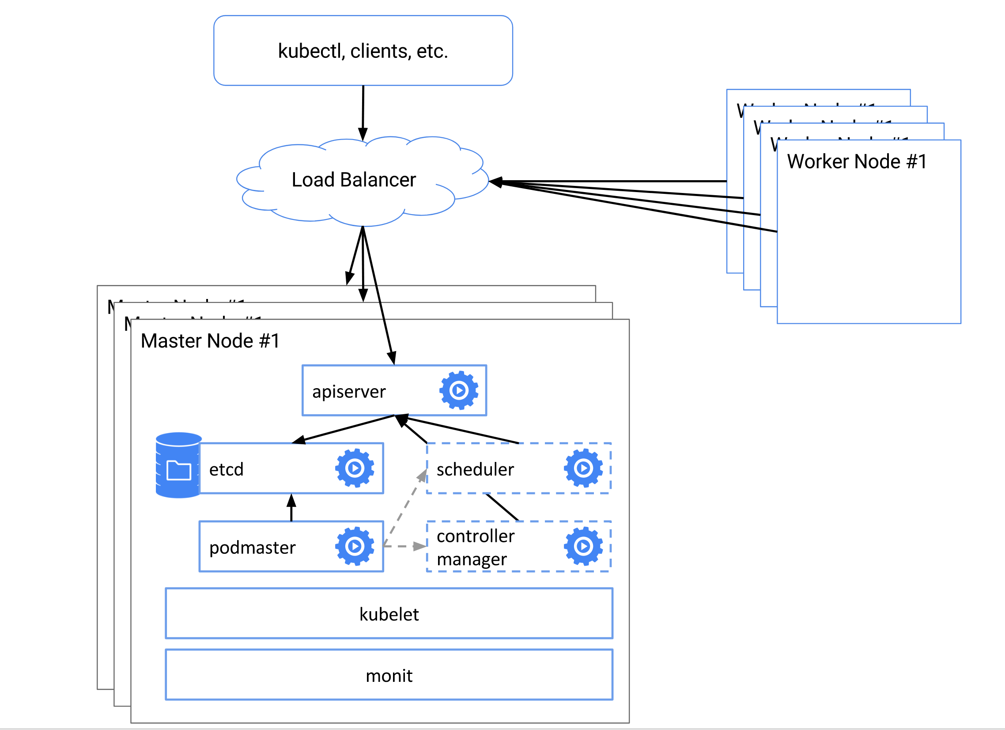
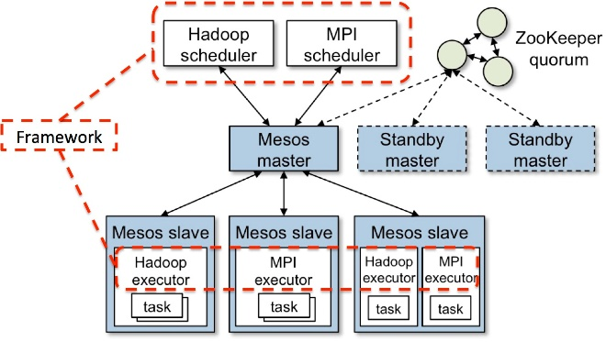
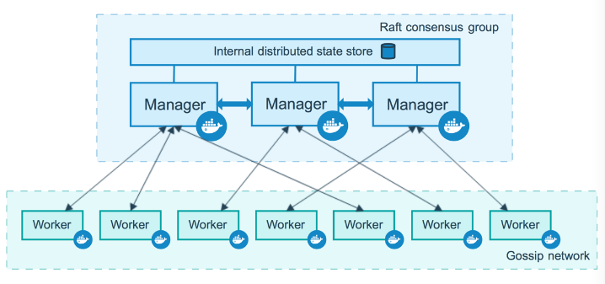

Container Platform Deployment Architectures
Open source platforms are very similar in architecture , horizontally scalable…
Master nodes – to manage the orchestration
Agent Nodes – to run the workload
And state stores – to keep platform state

Slide 37
Cust Question #1

Slide 38
Which PLATFORMS are you using?
The goal of this question is to identify which orchestrators and/or platforms a customer may be using or evaluating
Due to hype/popularity - there may be different groups using or evaluating at one company
Group or LOB led
Developer led
Corporate or IT initiative led
There may also be several orchestrators and/or platforms being evaluated at one time for different reasons
Application fit
ELAs
Maturity

Slide 39
Dell Industry Leadership

Slide 40
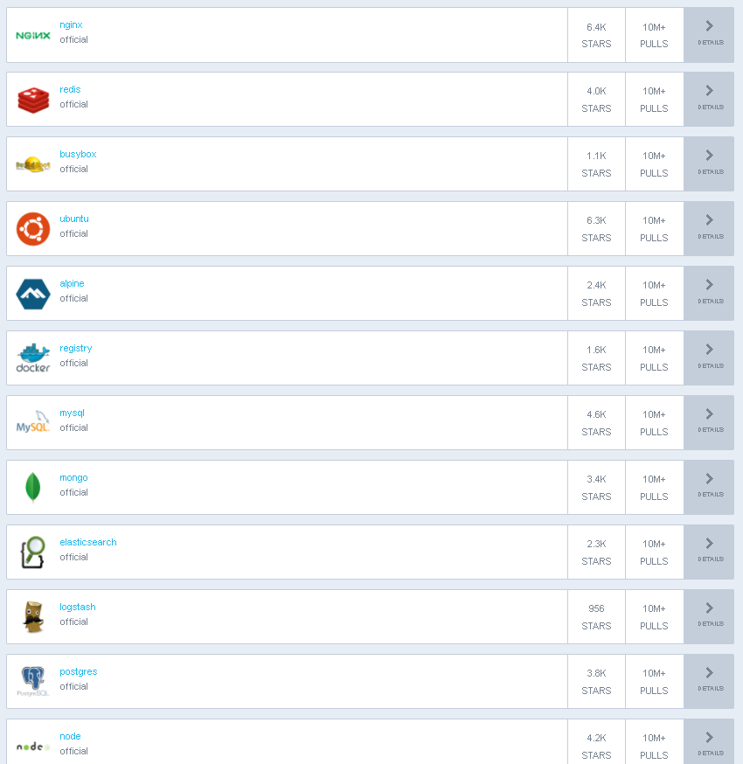
Container Storage Persistence is Important
hub.docker.com/explore
7 of 10 Top Require Persistence
Notes:
Container persistent storage is critical for customers
Proof point: Docker public Hub top downloads are overwhelmingly apps that need persistence
Also most conversations with customers I have are around applications with persistence needs – [discuss some of the applications listed here , apache solar etc]
Tell Josh B story
At Siri went from a dozen nodes to 80k+ nodes
Leveraged Containers through Mesos
Challenge was always container persistence – Josh had to do a lot of workarounds – none were ideal
Josh came to EMC to run the code team and open source leadership to solve this issue

Slide 41


Container Storage Persistence is Important
Storage persistence is the most challenging
… and better tools and solutions are needed.
Src: Portworx Annual Container Adoption Survey 2017 , n=491 IT pros
https://portworx.com/wp-content/uploads/2017/04/Portworx_Annual_Container_Adoption_Survey_2017_Report.pdf

Slide 42

REX-Ray
The leading container storage orchestration engine enabling persistence for cloud native workloads
Open Source and Community based
Supports key platforms
Enterprise Ready
High Availability
CLI Intuitiveness
Effortless Deployment
Architectural Choices
Multi-Platform Storage Management
Storage agnostic (block/file/object)
Provider | Storage Platform(s)
Amazon EC2 | EBS, EFS, S3FS
Ceph | RBD
Dell EMC | ScaleIO, Isilon
DigitalOcean | Block Storage
FittedCloud | EBS Optimizer
Google | GCE Persistent Disk
Microsoft | Azure Unmanaged Disk
OpenStack | Cinder
VirtualBox | Virtual Media
REX-Ray
rexray.codedellemc.com
Notes:
Now the {code} team could have created a closed POINT solution for container persistence for our own products. They took a more novel approach
The genius of {code}’s plan was to build a community around container persistence that was developer focused and leverage open source as an innovation arm.
And REX-ray was born! – [explain REX-Ray] – container storage orchestrator
Interoperates with upstream container orchestrators and choice of storage platforms
Quickly evolving container orchestrators and maturing persistence needs are a challenge for a container storage orchestrators – upstream container orchestrators and downstream storage providers are all doing things slightly different

Slide 43

Notes:
Dell Tech also became a platinum member of the Cloud Native Computing Foundation in march
[what is CNCF]
[what does it curate/host]

Slide 44


Container Storage Interface (CSI) Initiative
Created in March 2017 by stakeholders from Mesos, Google/Kubernetes, Docker, and Cloud Foundry
Exec Sponsor – Benjamin Hindman , Mesos Co-Founder
Sponsored by the Cloud Native Computing Foundation (CNCF) Storage Working Group
Docker, Mesos, Google/Kubernetes, RedHat, Dell EMC, NetApp, Western Digital, Cloud Foundry, Huawei, IBM, Pure, Quantum …
Define an industry standard and universal “container storage interface” (effectively an API)
Enable storage vendors to write a driver once and have it work across a number of container orchestration (CO) systems
CSI Spec - https://github.com/container-storage-interface
Notes:
Today 3-4 approaches to container persistence depending on the platform and
Docker – DVDI
Mesos – DVDI + DVDCLI
K8S – in-tree plugins and out-of-tree flexvol plugins
To help accelerate innovation and answer these challenges {code} helped form a community of leading vendors and open source groups around creating standard storage primitives for Container orchestrators and storage providers.
REX-Ray next version 0.10 will be CSI – Sept 11
CSI – Container Storage Interface
User experience was not great – too many approaches
Most of drivers were file system
Reality is that being bale to use a raw block device – use cases things exoect dist file system – clsueter awere ,
Csi – specification 0.1.x written -

Slide 45

Storage?
Notes:
Today the CNCF hosts multiple projects that are all key components of building a cloud native platform using container
Have mesh, networking etc
But no storage – our hope is that CSI becomes the vehicle for storage being a first class citizen under CNCF.

Slide 46
Cust Question #2

Slide 47
Do you need Storage Persistence?
The goal is to assess if the customer has moved beyond stateless apps
99.99% of customers we have encountered will say yes to this
Follow-up question is….
What apps?

Slide 48
How to Sell Dell Tech Capabilities for Container Platforms

Slide 49
What Can We Sell?
Dell Tech Solution Stack
Ready Solutions / CPSD
Reference Architectures
Platform Software
Storage
Servers

Slide 50
Server HW Matters…aka PowerEdge Matters… aka Bedrock of Container Platforms
Ready Solutions / CPSD
Reference Architectures
Platform Software
Storage
Servers
HW is cool again…
GPUs – Orchestrators building support
NVMe – High perf data sets in containers
NVDIMM – Extreme perf data sets and cache
HP and UCS users will say that they like the server bare metal / OS tools and support
Dell OpenManage has closed the gap
ProSupport Plus with TAM ups the game
RackHD for those that need OSS
Position Value PowerEdge servers with
Enterprise Support and Delivery that have commodity-based innovation and performance

Slide 51

Storage Considerations – Storage Drivers
Ready Solutions / CPSD
Reference Architectures
Platform Software
Storage
Servers
Container Platforms
Interface is needed for these things..
Create/Remove volumes
Inspect/List volumes
Attach/Detach volumes
Mount/Unmount volumes
Storage Driver
Cloud and Storage
Platform

Slide 52










Storage Drivers That Tie Back to Our Solutions Out of Tree
vSphere Docker Volume Service
REX-Ray
Nutanix Docker Volume Plug-in (DVP)
Distributed Storage Fabric
On DELL XC
Notes:
All are Docker certified - https://store.docker.com/search?category=volume&page=2&q=&type=plugin

Slide 53

Storage Drivers That Tie Back to Our Solutions In Tree
Native In-tree Drivers
REX-Ray
included in DC/OS
Notes:
All are Docker certified - https://store.docker.com/search?category=volume&page=2&q=&type=plugin

Slide 54
Storage Drivers That Tie Back to Our Solutions
 | REX-Ray | vSphere Docker Volume Service | Nutanix Docker Volume Plug-In | In-Tree Kubernetes Drivers
On-prem targets supported | Ceph ScaleIO Isilon | vSAN VMFS NFS | Nutanix Distributed File System (DSF) on DELL XC | ScaleIO vSphere
Known Orchestrator Compatibility | Docker Swarm Kubernetes (out of tree) Cloud Foundry Mesos & DC/OS | Docker Swarm | Docker Swarm | Kubernetes
Notes:
All are Docker certified - https://store.docker.com/search?category=volume&page=2&q=&type=plugin

Slide 55
Software Defined Storage
Ready Solutions / CPSD
Reference Architectures
Platform Software
Storage
Servers
Software defined storage is the best architectural “fit” for container platforms
Horizontal scale
Modularity
Service approach
vSAN vs ScaleIO?
Let your customer preferences and apps guide you
Strong VMware shop with no bare metal needs
Strong bare metal preference or other hypervisors
Developer “cool” kid, hoodies, or purists
Environment size and location
Don’t over look Isilon and ECS too
Agent Host 1
Agent Host 2
Agent Host 3
Agent Host n
Storage Node 1
Storage Node 2
Storage Node 3
Storage Node n
Notes:
Traditional architectures are still be viable

Slide 56
ScaleIO - Software Defined Storage for containers running on multi-hypervisor or bare metal
Agent Host 1
Agent Host 2
Agent Host 3
Agent Host n
SDClient
SDClient
SDClient
SDClient
Vol
Vol
IP Net
Storage Fault Domain
ScaleIO Node 1
ScaleIO Node 2
ScaleIO Node 3
ScaleIO Node n
Local Flash
Local Flash
Local Flash
Local Flash

Slide 57
 | Today | Future
Ready Solutions / CPSD | ScaleIO Ready nodes vSAN Ready Nodes VxRACK Flex VxRack SDDC (VMware) Dell XC
Reference Architectures | none
Platform Software | n/a, Open Source | Pivotal Kubo (Kubernetes+Bosh) *In Alpha Now, pricing model TBD

Slide 58


Kubo OSS and ODB
OSS - Apache2 project, jointly developed by Google & Pivotal to deploy a single K8 cluster with BOSH
ODB - BOSH-managed Kubernetes environments provisioned through a Cloud Foundry On Demand (Service) Broker.

Slide 59
 | Today | Future
Ready Solutions / CPSD | ScaleIO Ready nodes vSAN Ready Nodes VxRACK Flex VxRack SDDC (VMware) Dell XC PLUS Ready Bundle for OpenStack & OpenShift
Reference Architectures | None
Platform Software | Resell OpenShift through Dell S&P program

Slide 60
 | Today | Future
Ready Solutions / CPSD | ScaleIO Ready nodes vSAN Ready Nodes VxRACK Flex VxRack SDDC (VMware) Dell XC
Reference Architectures
Platform Software | n/a, Open Source

Slide 61

 | Today | Future
Ready Solutions / CPSD | ScaleIO Ready nodes vSAN Ready Nodes VxRACK Flex VxRack SDDC (VMware) Dell XC
Reference Architectures | Based on ScaleIO with REX-Ray @
Platform Software | Tech Connect Partner, resell through brokerage | Working on getting DC/OS into Select and/or S&P program
http://codedellemc.com/collateral/DellEMC-Mesosphere-Reference-Architecture.pdf
Notes:
http://codedellemc.com/collateral/DellEMC-Mesosphere-Reference-Architecture.pdf

Slide 62
 | Today | Future
Ready Solutions / CPSD | ScaleIO Ready nodes vSAN Ready Nodes VxRACK Flex VxRack SDDC (VMware) Dell XC
Reference Architectures | none
Platform Software | n/a, Open Source

Slide 63

 | Today | Future
Ready Solutions / CPSD |  | Azure Stack (Docker Swarm only) Shipping in Sept
Reference Architectures
Platform Software
SDS
Servers
Azure Stack will be Swarm only as current, which is just a simple ARM Template do deploy a Linux (Ubuntu) Based Docker Swam with an assigned Swarm Master

Slide 64
Cust Question #3

Slide 65
Are you considering Bare metal or VMs?
Advise customer on the factors that impact decision to use bare metal or VMs:
Existing virtualization footprint and support investments
Maturity of bare metal support
Security posture and politics
Existing bare metal deployment
Prioritization of other activities?
Thought Leadership :
VMware vSphere without DRS/HA etc – less licensing cost
“Free” ESXi with the understanding that they give up vCenter etc
Linux KVM with ScaleIO support

Slide 66

Tell us what you think!
Complete your survey for this session in the mobile app
Check your Activity Feed for Surveys to Complete
Select your current session
Answer a few questions and submit
It’s quick and easy!
Don’t have the app yet? Download it now!
Search for TRS FY18 from your device store – Windows, Android, iOS – and install

Slide 68
Deploying VMs
Deploying Containers
Deploying Code
Portals
Scripting
CI/CD Pipeline
Instantiation
vRealize Suite
VM CMPs
DIY Container
M&O
Commercial
PaaS and CaaS Suites
Platforms
Platforms
vRealize Suite
On-premises
Off-Premises
Compute/Capacity
Servers
HCI
Ready Solutions
Standardized
Specialized
Notes:
The first layer is the instantiation layer – this is where infrastructure interacts with the applications and developers to deplo instances – deploying VMs, deploying containers, or deploying code artifacts. There are 3 major approaches we see at customers:|
The first approach we see, in the middle top, is the classic service request plus scripting approach - A customer opens a ticket and some process is initiated to deploy something, mostly through a chain of sysadmin activities on workstations/laptops or from a centralized server. The best shops in this mode have moved on to using auto configuration tools like Puppet to create consistency. But we have also seen very manual processes too, including spreadsheets and the like.
On the left side you have the structured portal. This is where we create a catalog of services , mostly around deploying VMs , and provide access to app/dev stakeholders to create their own instances. This has become a key component in cloud strategies for customers and is core to our EHC cloud solution. This approach is a highly governed model and puts some guardrails on what can be instantiated. App/dev can only deploy the instances and workflows that are provided to them and in most cases changing workflows can involve many stakeholders and interdependencies.
On the far right side is the 3rd major approach – where Continuous integration , continuous delivery tools are chained together to form a pipeline . In this approach the control is given to app/dev to instantiate what they need. All we give to app/dev is a pool of capacity and some APIs. There is still some governance required , especially around security , however it is much more flexible.
In some cases these can be combined , especially 1 & 2 , in a phased approach to getting to a full self-service catalog.
Note that you may see CI.CD tools sets be used for VMs – in fact this were the CI/Cd tools started. Infact all the

